Slide 1
UNIVERSAL CHILDCARE By: Devina Martinez

Slide 2
CONTENT
What is the issue?
General History of Universal Childcare
Who is involved?
Why is this an issue?
What is the best resolution?

Slide 3
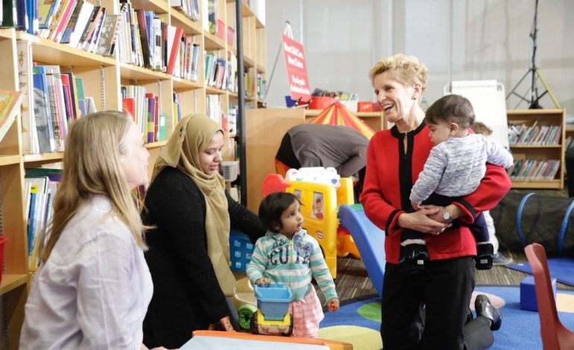
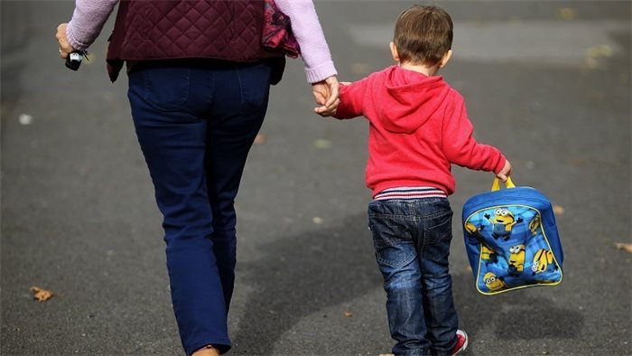
What is the issue? What is Universal Childcare?
1

Slide 4
What is the issue? What is Universal Childcare
Universal childcare is not a reality yet in Canada.
Universal childcare is plan to make quality childcare more affordable an accessible to all families in Canada
By doing this, we are also fighting other issues like the lack of women in the workforce

Slide 5
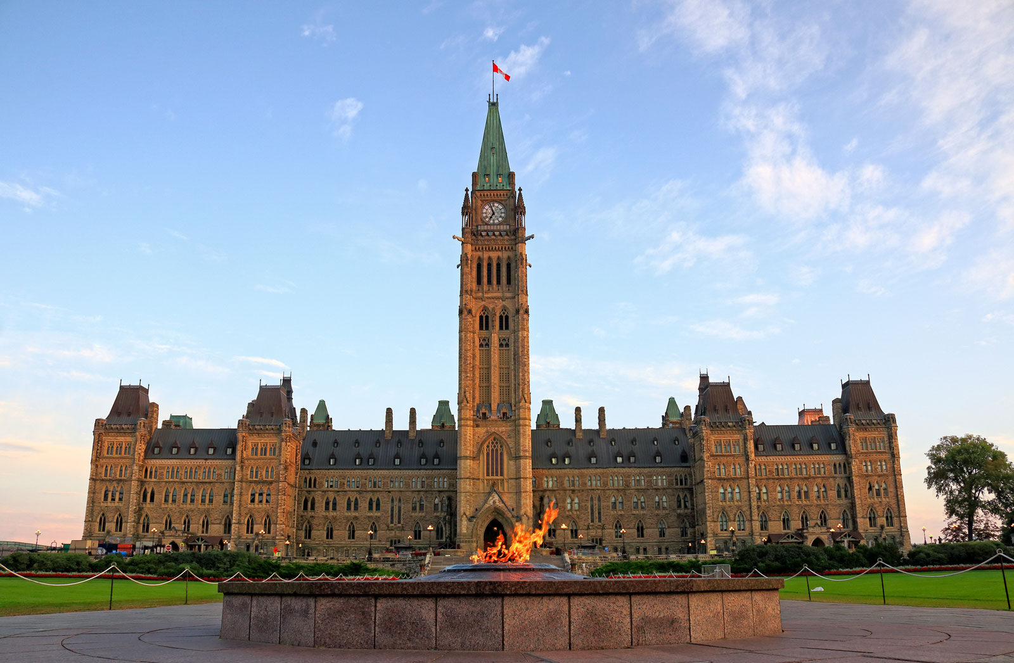
General History of Universal Childcare
2
When was in introduced, why did the implementation stop?

Slide 6
TIMELINE
1996
Quebec introduces low-fee, universal childcare in the province
2006
New government axes Paul Martin’s federal spending plan
1970
Royal Commission on the Status of Women- “unless this shared responsibility (childcare) is acknowledged and assumed, women cannot be accorded true equality
2018
“Gender Equality Budget” in federal budget. Supposed to encourage more women into employment.
1970
1975
1980
1985
1990
1995
2000
2005
2010
2015
2020
1986
Report from Federal Task force on childcare. Recommended was a universal system of affordable childcare co-funded by provincial/federal government
2003
Paul Martin’s Liberals put $1 billion of federal spending together with provincial/territorial action plans
2017
Federal government commits too transferring amounts of amounts to help provinces/territories with advances in childcare

Slide 7
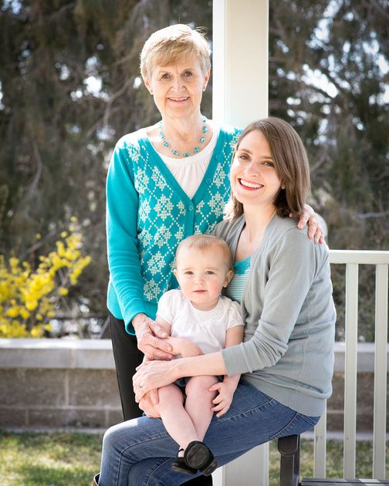
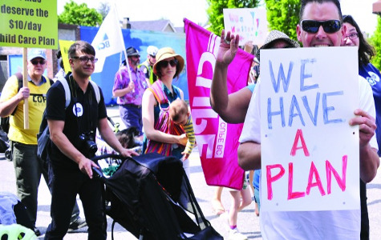
PRESENT DAY
In the present day, we now have generations of families that have been promised universal childcare that have not received it

Slide 8
Who is involved? What are the opposing sides?
3

Slide 9
Who is involved? What are the opposing sides?
Those for Universal Childcare
Article 24 and 18 in the Convention on the rights of the child
Affordable, Accessible, increase women in workplace, lower social supports, professional play for early childhood educators
Those against Universal Childcare
Cost the public lots of money
Negative effects from the program in Quebec

Slide 10
Want big impact?
USE BIG IMAGE.

Slide 11
Why is this an issue? What do both of these sides want?
4

Slide 12
Why is this an issue? What do both of these sides want?
Accessibility: specific lack of space for children under 18 months, spaces for 3 out of 10 under 5. Waiting lists for subsidy programs
Affordability: subsidy waiting lists, based on income, Childcare is expansive, keeps parents (mothers) at home, increases the amount of social support
Other: closing gender wage gaps, investments in childcare

Slide 13
$1320
$1080
$940
Monthly for infants
Monthly for toddlers
Monthly for preschoolers

Slide 14
A National Plan is Preferred…
Federal government has an important role to play in economic development, closing wage gaps, reducing poverty
Opportunity for Federal government to introduce national funding and standards

Slide 15
What is the best resolution? What needs to be done in order for this to occur?
5

Slide 16
What is the best resolution is our opinion? What needs to be done in order for this to occur?
Ontario Coalition for Better Child Care and CUPE presents 3 ideas:
1. Make childcare affordable
2. Provincial Wage Scale
3. Childcare expansion for public and not-for-profit programs

Slide 17
THANK YOU FOR LISTENING!

Slide 18
References
Baker, M., Gruber, J., & Milligan, K. (2019). The Long-Run Impacts of a
Universal Child Care Program. American Economic Journal: Economic Policy, 11(3), 1–26. https://doi.org/10.1257/pol.20170603
Convention on the Rights of the Child. Human nations Human Rights
Office of the High Commissioner. (n.d.).
https://www.ohchr.org/en/professionalinterest/pages/crc.aspx.
Friendly, M. (2015, November 6). A national child care system..."because it’s
2015". https://childcarecanada.org/blog/national-child-care-system%E2%80%9Cbecause- it%E2%80%99s-2015%E2%80%9D.

Slide 19
Friendly, M. (2016, February 4). @petermansbridge to @JustinTrudeau: "It’s
2016. Isn't it time for a national day care program?". ChildCare Canada. https://childcarecanada.org/blog/petermansbridge-justintrudeau-its-2016-isnt-it-time-national-day- care-program%E2%80%9D.
Friendly, M., Prentice, S., & Ballantyne, M. (2018, March 8). No equality
without universal child care. ChildCare Canada. https://childcarecanada.org/blog/no-equality-without- universal-child-care.
Gunaseelan, V. (2021, January 27). A new normal for child care in Canada:
Accessible, affordable, universal. Wellesley Institute. https://www.wellesleyinstitute.com/children- youth/a-new-normal-for-child-care-in-canada-affordable-accessible-universal/.

Slide 20
MacDonald, L. (2020, October 22). The Compelling Case Against Universal
Child Care. Business Examiner. https://businessexaminer.ca/victoria-articles/item/the-compelling- case-against-universal-child-care/.
MacLeod, D. (2018, May 11). The perfect gift for Mother's Day: Universal
child care. ChildCare Canada. https://childcarecanada.org/blog/perfect-gift-mothers-day-universal-child-care.
McCluskey, M. (2018, December 31). The Global Legacy of Quebec's Subsidized Child Daycare.
Bloomberg.com. https://www.bloomberg.com/news/articles/2018-12-31/affordable-daycare-and-working- moms-the-quebec-model.
The Ontario Coalition For Better Child Care. (2018). Universal Child Care Is
Possible! YouTube. https://www.youtube.com/watch?v=X9Ig9SF_ZOg.
Ontario. Finding quality child care. (n.d.). https://findingqualitychildcare.ca/ontario.

