Slide 1
Modern Language Association (MLA)
Your guide to MLA formatting

Slide 2
What is the purpose of MLA?
MLA provides writers with a uniform format for document layout and documenting sources.
Properly documenting sources also ensures that an author is not plagiarizing.

Slide 3
Together we will cover:
Website evaluation
General MLA guidelines
First page format
In-text citations
Formatting quotations
The Works Cited page

Slide 4
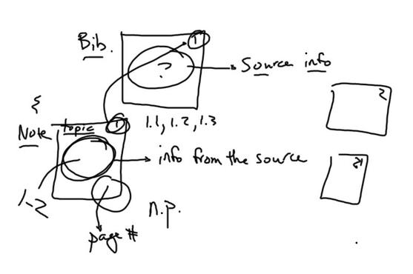
It does not have to be complicated!

Slide 5
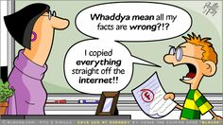
Website Evaluation

Slide 6
Website Evaluation
Before you retrieve information off the internet, you must check the following:
Authority – who is the author of the website/article?
Accuracy – does the website provide references to other sources?
Objectivity – is the information provided bias, persuasive or informative?

Slide 7
Website Evaluation
Scope/Intent – is the information comprehensive? What is the purpose of the website generally?
Format/Presentation – does it look professional, easy to read, user friendly, and clear?
Currency – when was it last updated? Does it have active links?

Slide 8
Website Evaluation – Remember this
* The web address provides clues as to whether the website is credible or not.
All you have to do it look for:
.com = commercial organizations
.org = non-commercial organizations
.edu = educational institutions or universities
.net = internet service and providers
.gov = government agencies

Slide 9
General Guidelines
An MLA Style Paper should:
Be typed on white 8.5“ x 11“ paper
Double-space everything
Use 12 pt. Times New Roman (or similar) font
Leave only one space after punctuation
Set all margins to 1 inch on all sides
Indent the first line of paragraphs one half-inch

Slide 10
First Page
The first page of an MLA Style paper will:
Have no title page
Double space everything
List your name, your instructor's name, the course, and date in the upper left-hand corner
Center the paper title (use standard caps but no underlining, italics, quote marks, or bold typeface)
Create a header in the upper right corner at half inch from the top and one inch from the right of the page (list your last name and page number here)

Slide 11
First Page

Slide 12
MLA is fun. We ARE having FUN.

Slide 13
In Text Citations
Within the text MLA uses parenthetical citations.
You need to give credit to a source any time you use information from the source in the following ways:
Direct Quotation
Paraphrase

Slide 14
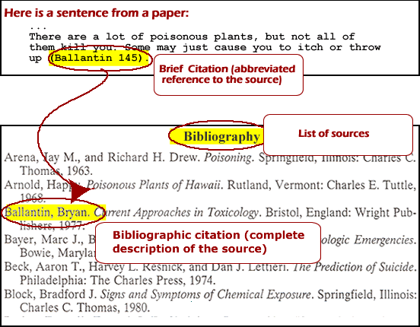
In Text Citations – Quote

Slide 15
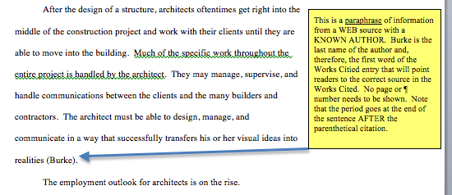
In Text Citations – When Paraphrasing

Slide 16
In Text Citations - No Author?
In-text Example, citing a work with no known author –
We see so many global warming hotspots in North America likely because this region has “more readily accessible climatic data and more comprehensive programs to monitor and study environmental change…” (“Impact of Global Warming” 6).

Slide 17
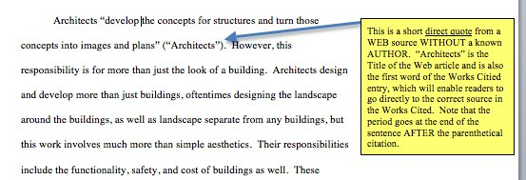
In text Citations – Web Page

Slide 18
MLA is cool!

Slide 19
In Text Citations
Keep this in mind –
Block Quotations – must be longer than three lines, set off from main body of paragraph (like a block).
Integrated Quotations – three lines of text or fewer, flows seamlessly in the paragraph.

Slide 20
In Text Citations – More than One Author
In-text Examples:
Smith, Yang, and Moore argue that tougher gun control is not needed in the United States (76).
The authors state “Tighter gun control in the United States erodes Second Amendment rights” (Smith, Yang, and Moore 76).
Jones et al. counter Smith, Yang, and Moore's argument, noting that the current spike in American gun violence compels law makers to adjust gun laws (4).

Slide 21
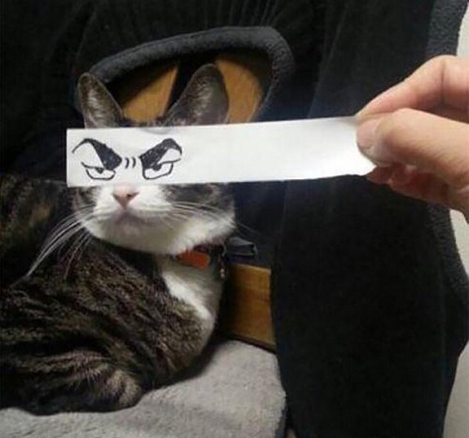
SMILE! It is ALMOST over!

Slide 22
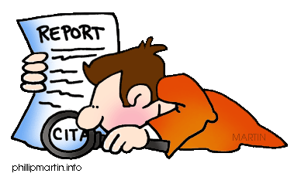
Works Cited - Book

Slide 23
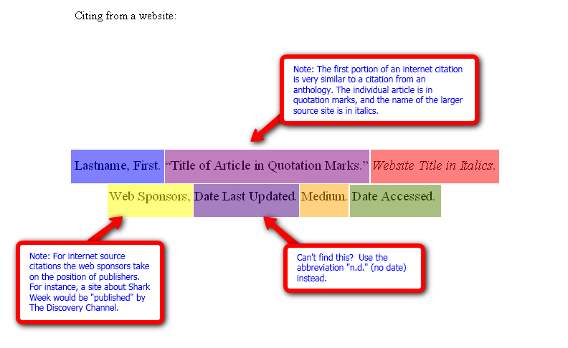
Works Cited - Web

Slide 24
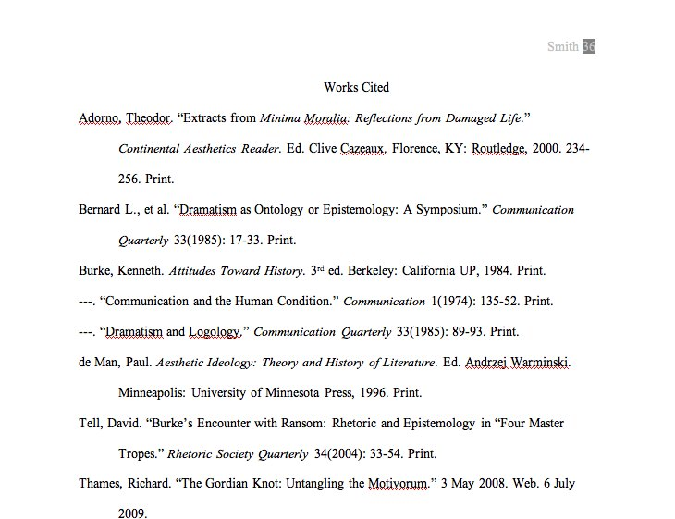

Slide 25
You Made It!

