Slide 1
How to convert decimals to fractions, and to percentages
Par: Mlle Alessandra

Slide 2
How to convert a fraction to a decimal?
Examples
Fraction: 3/4
3 $÷4=0.75$

Slide 3
How to convert a decimal to a percentage?
Example
Fraction 3/4= 0.75
*a percentage is always multiplied by 100
0.75 x 100 = 75%

Slide 4
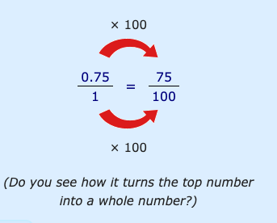
How to convert a decimal into a fraction?
Step #1 write down the decimal divided by 1
0.75$÷$1
Step #2 multiply both top and the bottom number by 100 (because there are 2 digits after the decimal point so that is 10 x 10 = 100)

Slide 5
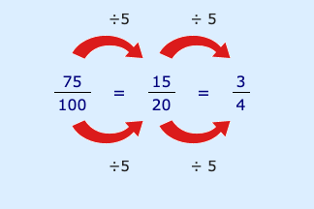
Cont…
Step #3 simplify the fraction as much as you can

